Slide 1
PeerWise Cycle 3
Answering Metrics
How does your Question Perform?

Slide 2
Cycle 2 Generated Lots of Questions
70-90 per tutorial group
Over 650 in total
Each question was
Created after sourcing grass-roots intelligence
Misconceptions, misunderstandings, insights, revelations
All hopefully done as a group (and recorded on LabArchives, of course!)
Perhaps even at the highest level of Blooms
Critiqued by at least four people
With everyone giving high-quality, ACTIONABLE comments
Revised in the light of the feedback

Slide 3
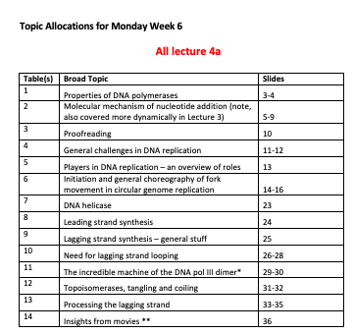
Questions Perfectly Aligned with Syllabus
Course | Day | Cycle 2 Topics
BCMB | Mon | L7, L4b
 | Tue | L6
 | Wed | L5
 | Thur | DNA fingerprinting
MEDS | Mon | L4
 | Tue | Spectrophotometry
 | Wed | L2, L1
 | Thur | L3, L2
All learning outcomes covered at just the right level of granularity!!
We will have ~6 MCQs per granular learning outcome

Slide 4
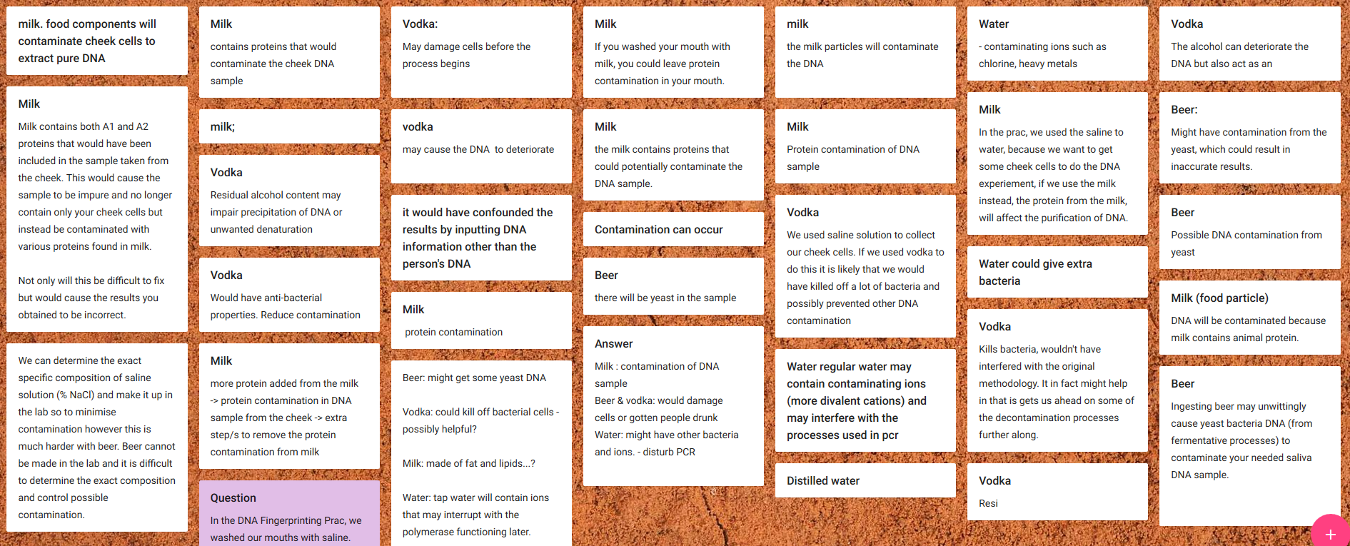
Process: Harvesting Ideas
Milk proteins - contamination
Ethanol - disinfectant
Beer – yeast DNA
Water – ions & Taq

Slide 5
Process: A Draft Question
The protein from the milk will contaminate the DNA preparation reducing the accuracy of the final results
The vodka will kill bacteria leaving us with a less contaminated DNA preparation which will improve our final results
The vodka will precipitate the DNA which will greatly increase the purity of our preparation
Beer will contaminate our DNA preparation with yeast sequences but this won’t matter
The water will contain ions that will affect the Taq polymerase and ruin our results
Constructed in just a few mins….
But this was not subjected to group criticism – which is an advantage that YOU had

Slide 6
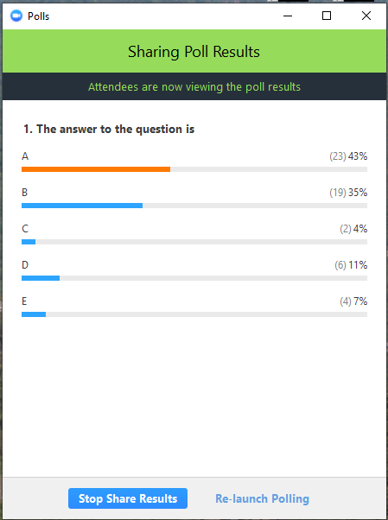
Process: Testing Performance
The protein from the milk will contaminate the DNA preparation reducing the accuracy of the final results
The vodka will kill bacteria leaving us with a less contaminated DNA preparation which will improve our final results
The vodka will precipitate the DNA which will greatly increase the purity of our preparation
Beer will contaminate our DNA preparation with yeast sequences but this won’t matter
The water will contain ions that will affect the Taq polymerase and ruin our results
What do we do about this intelligence?
Explore that theme of human specific primers more?
Reflect that it is unfair to confuse with the concept of ‘contamination’?
What is the distribution lacking?
Which students chose each answer ☺!
Understanding WHY they made the choices
The correct option was actually D
What do you think about that?

Slide 7
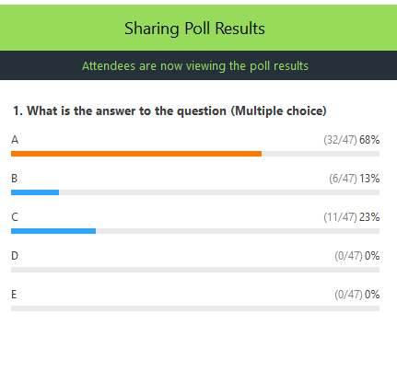
Process: Here’s another one
In the DNA Fingerprinting procedure, we washed our mouths with saline. Perhaps we could have used other liquids.
Which statement is TRUE?
Saline used to sterilise the saliva – means we don’t get contamination with bacterial DNA
Vodka will sterilize the sample and give less bacterial DNA so the results would be better
It doesn’t matter if we get bacterial DNA in the final sample
Hot tea will sterilize the sample and give less bacterial DNA so the results would be better
Are all the options ‘performing’?

Slide 8
Importance of Metrics
We need to find out how the question PERFORMS
How many people get it right/wrong?
What is ideal?
Is it hard or easy?
We do want a blend of ‘pass’ and ‘HD’ level questions
Is it discriminating fairly?
Are the Fs getting it right and the HDs getting it wrong!!??
This is the worst-case scenario!
Are some of the options ambiguous?
How do we know?
Are some of the options not performing?
Too often chosen or not chosen at all

Slide 9
Getting the Metrics
Each student to ANSWER at least 40 questions
Seems a lot, but at 2 min per question it is <1.5 hours
Which is the length of the MCQ section of the exam
And that is just about all there is for this cycle
Do NOT need to comment or even rate
Although these always appreciated and is useful for YOU
Obviously, a benefit to YOU and OTHERS if you do more
But we only get good metrics if people answer HONESTLY
So, how to achieve that?

Slide 10
Promoting Earnest Answering
Give marks for correctness?
Author is not always ‘right’
I reckon at least 10% of academic-set Qs are wrong ☺
I can make it clear that it is not the Author’s correctness, it is mine
I can check conflicts and ensure no-one is penalized for an ambiguity
So use the ‘doubt’ button if you are sure
But not all students at same stage of understanding
Don’t want to penalize honest, wrong answers

Slide 11
Promoting Earnest Answering
Check timing
Need to spend 2 min per question
Unless get it right… in which case OK to do it fast
Ensure that people don’t just pick easy ones
Should be irrelevant as not judged on score
BUT that may not be convincing enough
So, final collection must have a blend
Have not decided on proportions yet
If you always do the least answered or random then it will be sufficiently spread
Try to pick the least answered

Slide 12
Promoting Earnest Answering
Identifier is your Unikey
We have added some genuine exam questions to each pool!
That should at least encourage volume of engagement!
So we have copied your questions to new site
You cannot easily identify which are ours
No authoring, editing, etc.
 | Course IDs
Day | BCMB (Week 5) | MEDS (Week 6)
Mon | 21230 | 21234
Tue | 21231 | 21235
Wed | 21232 | 21236
Thurs | 21233 | 21237

Slide 13
Timing
Do by midnight on your tutorial day next week
I will then generate the performance data
I will then feed that through to you
You can change the original question in Cycle 2 if you wish
To be done before the start of Cycle 4
Performance checked, edited questions may appear in final exam!!
At the end of Cycle 3
I will pool all the best questions into a revision site
Lectures 1-7 and Pracs 1 and 2
What a resource!

Slide 14
Start Cycle 4
Today
7 days
14 days
*
Answer >40 questions
Gareth compiles performance data
Edit in Cycle 2
* Mid-semester break complicates things for BCMB.
Effectively I am resigned to getting your answers in Week 8

Slide 15
Workload
1.5 hours to answer the questions
That’s it….
Editing your question afterwards is optional
An incentive is consideration for inclusion in Week 13 test
Not much of an incentive admittedly
Test = 10%, will contain at least 30 MCQs delivered at random
Will be tweaked by academics

